Slide 1
Memory Layout of C Programs

Slide 2
A typical memory representation of a C program consists of the following sections.
Text segment
Initialized data segment
Uninitialized data segment
Stack
Heap

Slide 3
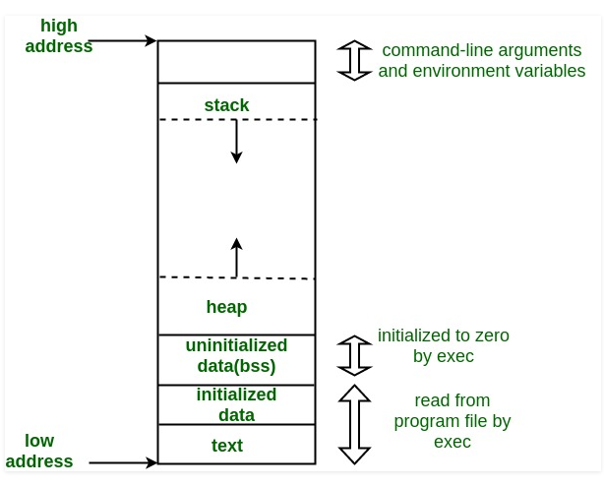

Slide 4
Text Segment
A text segment, also known as a code segment or simply as text, is one of the sections of a program in an object file or in memory, which contains executable instructions.
Placed below the heap or stack.
Usually, the text segment is sharable
Also, the text segment is often read-only

Slide 5
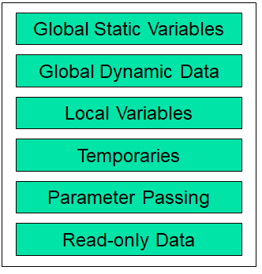
Initialized Data Segment
Simply the Data Segment
A data segment is a portion address space where variables that are initialized by the programmer.
Classified into the initialized read-only area and the initialized read-write area.

Slide 6
Uninitialized Data Segment
Uninitialized data segment often called the “bss” segment, that stood for “block started by symbol.”
Data in this segment is initialized by the kernel to arithmetic 0 before the program starts executing

Slide 7
Stack
The stack area traditionally adjoined the heap area and grew in the opposite direction
Stack contains local variables from functions . LIFO structure.
Function variables are pushed onto stack when called.
Functions variables are popped off stack when return.
Temporary memory during lifetime of a function or block
The set of values pushed for one function call is termed a “stack frame”

Slide 8
Heap
Heap is a chunk of memory that users can use to dynamically allocated memory.
Lasts until freed, or program exits
The Heap area is managed by malloc, realloc, and free
The Heap area is shared by all shared libraries and dynamically loaded modules in a process.

Slide 9
Memory Layout Example
char* string = “hello”;
int iSize;
char* f(void)
{
char* p;
iSize = 8;
p = malloc(iSize);
return p;
}
Text
Data
BSS
Heap
Stack

Slide 10
Memory Layout Example: Text
char* string = “hello”;
int iSize;
char* f(void)
{
char* p;
iSize = 8;
p = malloc(iSize);
return p;
}
Text
Data
BSS
Heap
Stack

Slide 11
Memory Layout Example: Data
char* string = “hello”;
int iSize;
char* f(void)
{
char* p;
iSize = 8;
p = malloc(iSize);
return p;
}
Text
Data
BSS
Heap
Stack

Slide 12
Memory Layout Example: BSS
char* string = “hello”;
int iSize;
char* f(void)
{
char* p;
iSize = 8;
p = malloc(iSize);
return p;
}
Text
Data
BSS
Heap
Stack

Slide 13
Memory Layout Example: Heap
char* string = “hello”;
int iSize;
char* f(void)
{
char* p;
iSize = 8;
p = malloc(iSize);
return p;
}
Text
Data
BSS
Heap
Stack

Slide 14
Memory Layout Example: Stack
char* string = “hello”;
int iSize;
char* f(void)
{
char* p;
iSize = 8;
p = malloc(iSize);
return p;
}
Text
Data
BSS
Heap
Stack

